Slide 1
STUDY
BUDDY
STUDY TOGETHER, GROW TOGETHER, EARN TOGETHER

Slide 2

INTRODUCTION
WE PROVIDE COLLABORATIVE WHITEBOARD AND VIDEO
CALLING SERVICES.

Slide 3

ABOUT
Through our website, users will be allowed to study together or maybe prepare for an interview together.
We will provide users with a collaborative whiteboard and a video calling option.

Slide 4

1) COLLABORATIVE WHITEBOARD
A real- t ime collaborative whiteboard will allow users to write whatever they want.
So this will allow two people to s imultaneously work on the same whiteboard.
Use cases: can discuss programming problems, mathematical problems, etc.
Tech stacks required : a. Express js
b. Socket io c. Node js

Slide 5
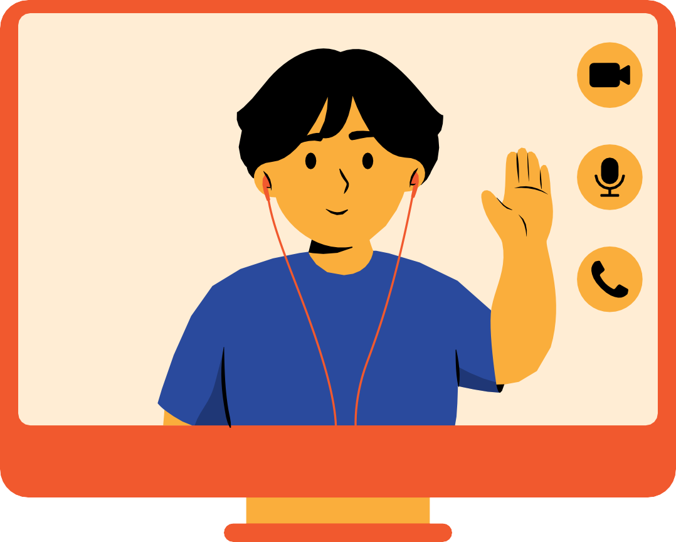
fi) VIDEO CALLING FEATURE
Video calling feature will allow the users to interact.
This feature will work along the
whiteboard( i . e users can work on whiteboard and talk on video call simultaneously)
Tech stacks required : a. Web RTC API
b. Node js
c. socket io( for signaling in Web RTC)

Slide 6
ALL TECH STACKS
HTML
Web RTC
GIT VCS
CSS
SOCKET IO
JAVASCRIPT
EXPRESS JS
NODE JS
GITHUB

